Slide 1

SME Finder Agent
Copilot Scenario Overview Deck
© 2026 Microsoft Corporation All rights reserved.

Slide 2
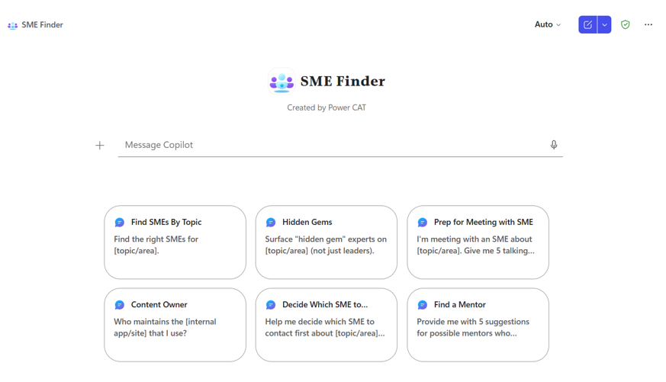
SME Finder Agent Summary
Agent Overview
Key Challenges
Surface the most relevant subject matter experts for any topic using real Microsoft 365 work signals, ranked by demonstrated expertise, recency, and organisational relevance — with a ready-to-use introduction message.
Hours wasted browsing org charts and asking around on Teams
Reliance on personal networks reduces decision quality
Repeated outreach delays execution and frustrates SMEs
No visibility into who is the credible expert for a topic
Business Outcomes
Hours wasted browsing org charts and asking around on Teams
Reliance on personal networks reduces decision quality
Repeated outreach delays execution and frustrates SMEs
No visibility into who is the credible expert for a topic
Technical Features
💬 Conversational access via Microsoft 365 Copilot
📋 Declarative agent grounded in mailbox, Teams Chats, SPO
🔍 Signal-based SME ranking by recency, evidence, and relevance
✍️ Personalised, copy-paste-ready introduction message
© 2026 Microsoft Corporation All rights reserved.

Slide 3
Table of Contents
Overview
Persona Example
User Journey Scenario Example
Solution Screenshots
Demo Prompts

Slide 4
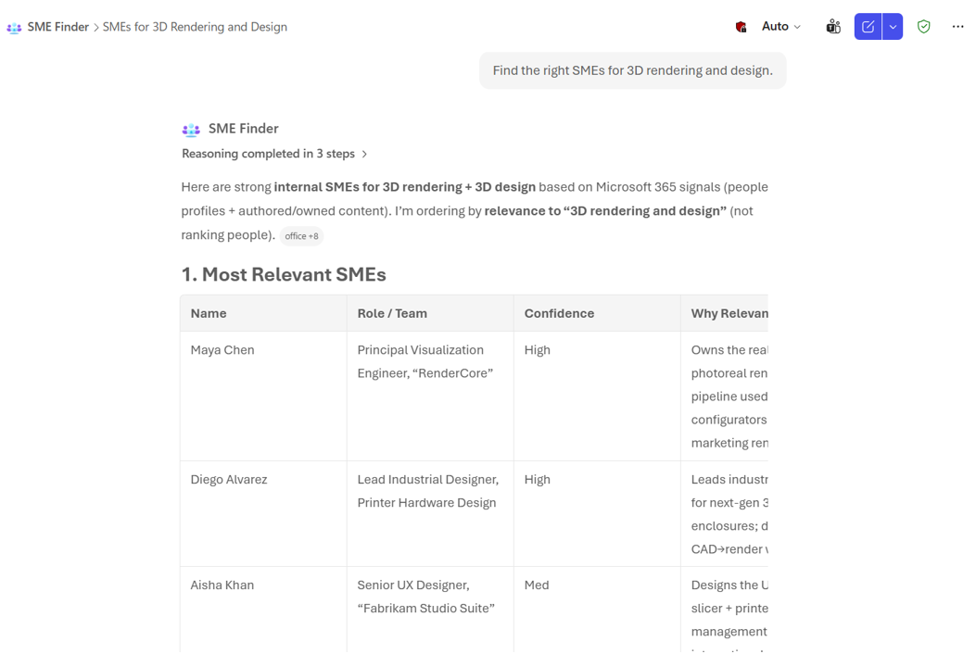
SME Finder is a declarative agent that uses Microsoft 365 work signals to surface the most relevant subject matter experts for a given topic. It ranks SMEs based on demonstrated expertise, recency, and organisational relevance.
The agent also generates a personalised, copy-paste-ready introduction message tailored to the SME’s seniority, role, and the user’s topic — accelerating effective collaboration.
Overview
© 2026 Microsoft Corporation All rights reserved.

Slide 5


Persona Example
Two core personas: the seeker who needs an expert and the SME who gets the right ask, with the right context, the first time.
Knowledge Worker
Subject Matter Expert
Seeker
Connected expert
Needs help with a specific topic, project, or product area
Wants a credible expert and a fast, professional intro
Receives focused asks with the right context
Spends less time on triage and broad outreach
Typical Ask
Typical Reach-out
“Who is the best SME for Azure security in my organization?”
Receives a clear, contextual, copy-paste introduction from the seeker
Key Challenges Addressed
Hours wasted finding the right expert; reliance on personal networks reduces decision quality; repeated outreach delays execution and frustrates SMEs.

Slide 6


User Journey
From a topic to a ranked list of credible experts and a ready-to-send intro — the agent removes the manual hunt for the right person.
1
Trigger
2
Evaluation
3
Output
User asks the agent in Copilot, e.g., “Who is the best SME for Azure security?” or “Find an SME for Microsoft 365 Copilot agent development”
Agent searches Microsoft 365 work signals and ranks SMEs by demonstrated expertise, recency, and organisational relevance.
Ranked SMEs plus a personalised intro message
Backbone
Microsoft 365 Graph signals
Signal-based SME ranking
Intro message generation

Slide 7







High Level Agent Architecture
SME Finder Agent
How it works
User interacts with the agent via Microsoft 365 Copilot
Declarative agent searches Email, Teams Chats and Meetings, SharePoint, & People signals
Agent suggests SMEs by relevancy, recency, evidence, and organizational context
Returns ranked SMEs plus a copy-paste-ready intro message
Microsoft Teams
Outlook
SharePoint
1
2
End User
SME Finder Agent
Teams
People
Developer
Maker
Knowledge Worker
Declarative Agent
Microsoft 365 Copilot
Knowledge Sources

Slide 8
Agent Solution Screenshots
© 2026 Microsoft Corporation All rights reserved.

Slide 9
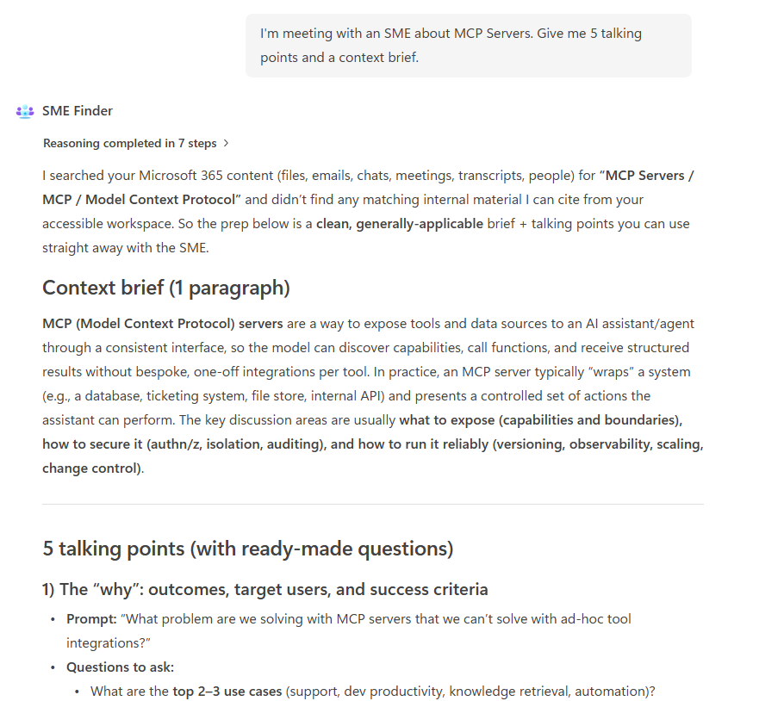
Agent Snapshot

Slide 10
Demo Prompts & Eval Set

Slide 11
Demo Prompts & Eval Set
ID | Test Scenario | Prompt | Expected Result
1 | Find SMEs By Topic | "Find the right SMEs for [topic/area]." | 4-section Output Contract: Top SMEs table + cited evidence + outreach in a code block + next steps.
2 | Hidden Gems | "Surface “hidden gem” experts on [topic/area] (not just leaders)." | 3-5 ICs / cross-team experts; excludes Director+ and top-cited names. Each row is evidence-cited.
3 | Prep for Meeting with SME | "I’m meeting with an SME about [topic/area]. Give me 5 talking points and a context brief." | Exactly 5 evidence-backed talking points + a one-paragraph context brief, each tied to a cited signal.
4 | Content Owner | "Who maintains the [internal app/site] that I use?" | Primary owner + Backup with cited source (site permissions / admins) and a draft outreach message.
5 | Decide Which SME to Contact First | "Help me decide which SME to contact first about [topic/area] — and why." | Side-by-side outreach prioritization on Topical, Recency, Seniority fit, Availability — not expertise ranking.
6 | Find a Mentor | "Provide me with 5 suggestions for possible mentors who specialize in [topic/area]." | Exactly 5 mentor candidates meeting tenure, coaching, and org-distance criteria — with intro messages.
7 | Go-To Person | "Who’s the go-to person for [topic] when teams get stuck?" | Output Contract emphasizing Org Trust signals — cross-team visibility, DRI/tech-lead, escalation threads.
8 | Become a SME | "I want to become a SME on [topic]. What should I do?" | Cited mentors + content owners + communities of practice. Evidence-grounded learning path, no generic advice.
9 | Hidden Gems on My Team | "List hidden gem SMEs on my team in a table." | Skill 8 hidden gems scoped to the user team via People graph, rendered as a table; no Director+ titles.
10 | Same Office Location | "Find SMEs in [topic] based in the same office location as me." | Output Contract filtered by user office location via People graph; Skill 7 fallback if none qualify.

Slide 12
Thank You

